Slide 1
Visual Network Analysis
Visual Analytics Project
Alessandro Giannetti Gianluca Tasciotti
Visual Analytics 2018/2019

Slide 2
Introduction
With this project, we are going to illustrate a possible visualization of a dataset in which are present a huge quantity of attacks. We will see some techniques to represent it and which problems we crossed to show it in the best way.

Slide 3
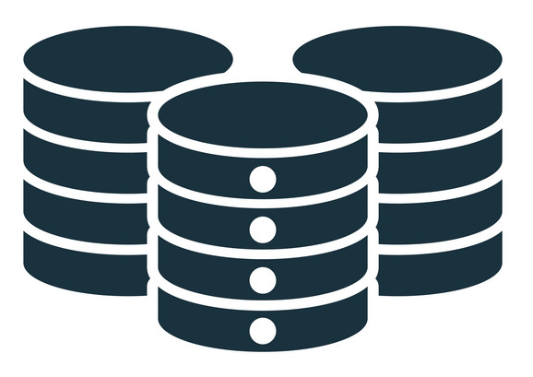




Pipeline
DATASET
TECHNOLOGIES
VISUALIZATIONS
ACTIONS
FILTERS

Slide 4
Dataset
Intrusion Detection Evaluation Dataset (CICIDS2017)
Format: CSV
Dimension: 48.00 GB
Protocols: HTTP, HTTPS, FTP, SSH, and E-mail protocols
Days: 3rd of June 2017 at 9:00 to 7th of June 2017 at 17:00
Parameters: Flow ID, Source IP, Source Port, Destination IP, Destination Port, Protocol, Timestamp, Label, TotalLengthOfFwdPackets, Flow Duration, Total Fwd Packets, Total Bwd Packets etc.
Example: 172.16.0.1-192.168.10.50-17560-80-6, 172.16.0.1, 17560, 192.168.10.50, 80, 6, 7/7/2017 3:59, 1341015, 5, 0, 30, 0, 6, 6, 6, 0, 0, 0, 0, 0, 22.37111442, 3.72851907, 335253.75, 669835.666, 1340007, 1, 1341015, 335253.75, 669835.666, 1340007, 1, 0, 0, 0, 0, 0, 0, 0, 0, 0, 100, 0, 3.72851907, 0, 6, 6, 6, 0, 0, 0, 0, 0, 0, 1, 0, 0, 0, 0, 7.2, 6, 0, 100, 0, 0, 0, 0, 0, 0, 5, 30, 0, 0, 256, -1, 4, 20, 0, 0, 0, 0, 0, 0, 0, 0, DDoS

Slide 5
Dataset Manipulation
We have selected only 7 of the most significant out of 85 parameters:
Source IP
Destination Port
Destination IP
TotalFwdPackets
We have removed all samples with Label equal to BENIGN
The most frequently used Destination Port, Source IP and Destination IP
The dataset proposed respects the AS rule: #tuples * #dimensions between 10.000 – 50.000
~ 5,16 secs computation time (Proposed Solution) → AS = 5.510 * 7 = 38.570
~ 30,5 secs computation time (Discarded Solution) → AS = 63.028 * 7 = 441.196
TotalLengthOfFwdPackets
Timestamp
Label

Slide 6
Dataset → Manipulated Dataset
Example of Initial Dataset Line
Flow ID: 172.16.0.1-192.168.10.50-17560-80-6, Source IP: 172.16.0.1, Source Port: 17560, Destination IP: 192.168.10.50, DestinationPort: 80, Timestamp: 7/7/2017 15:59, + 79 fields… Label: DDoS
Example of Final Dataset Line
Source: 172.16.0.1, DestinationPort: 80, Target: 192.168.10.50, Timestamp: 7/7/2017 15:59, TotalFwdPackets: 8, TotalLengthOfFwdPackets: 56, Label: DDoS

Slide 7
Pipeline
DATASET
TECHNOLOGIES
VISUALIZATIONS
ACTIONS
FILTERS

Slide 8



Technologies
Python
Dataset manipulation
D3 + JS
Dataset Visualization
+

Slide 9
Pipeline
DATASET
TECHNOLOGIES
VISUALIZATIONS
ACTIONS
FILTERS

Slide 10
Visualizations
Graph

Slide 11
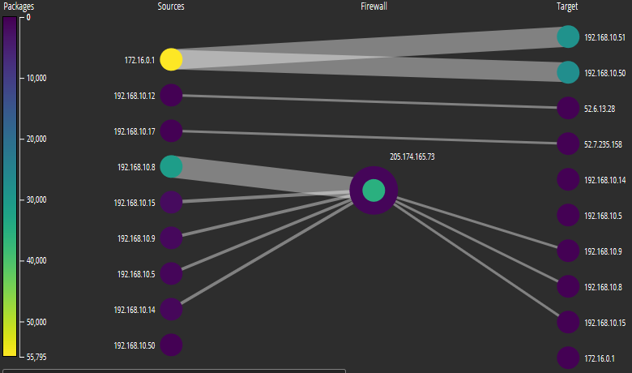
Graph
Nodes: IP address
Edges: Packages exchanged between two parties
Bipartite Graph With 3 Layers:
Attackers
Firewall
Targets

Slide 12
Graph
Colour Of Nodes : Based on the number of packets they sent and received
Edge Thickness : Based on the number of packets passing through the source and target

Slide 13
Visualizations
Graph
PCA

Slide 14
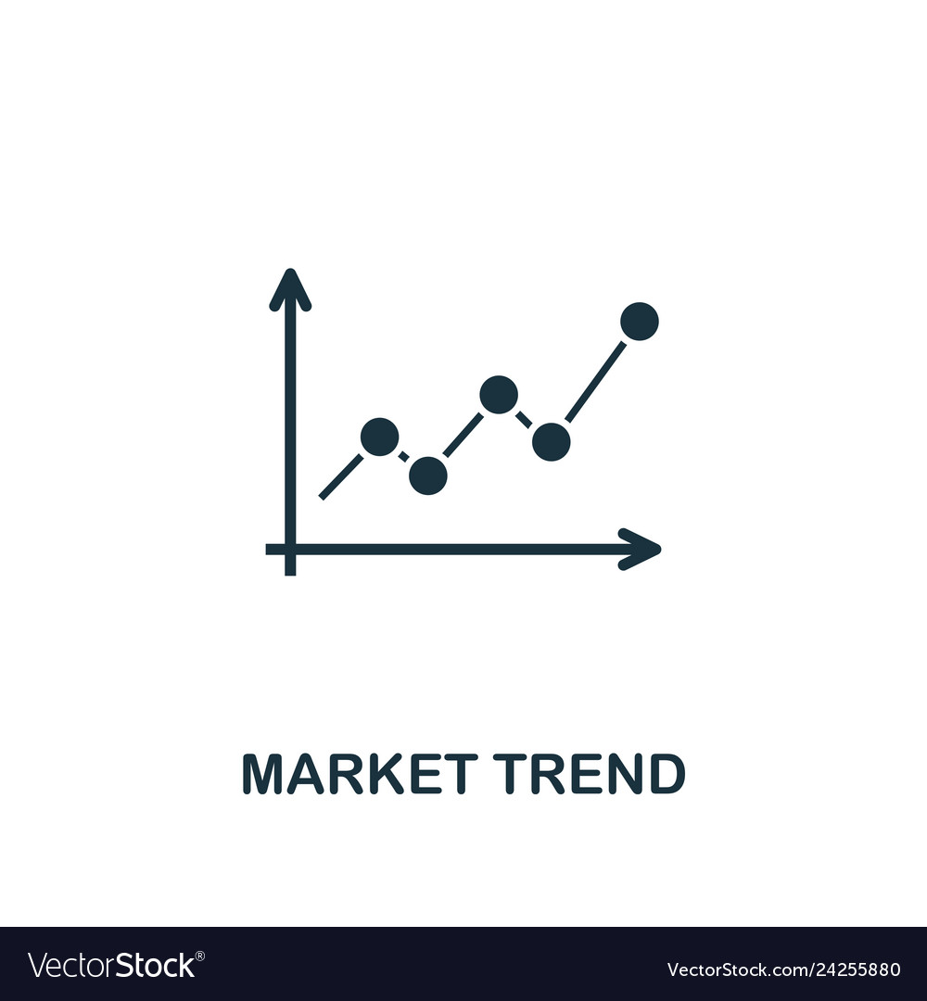
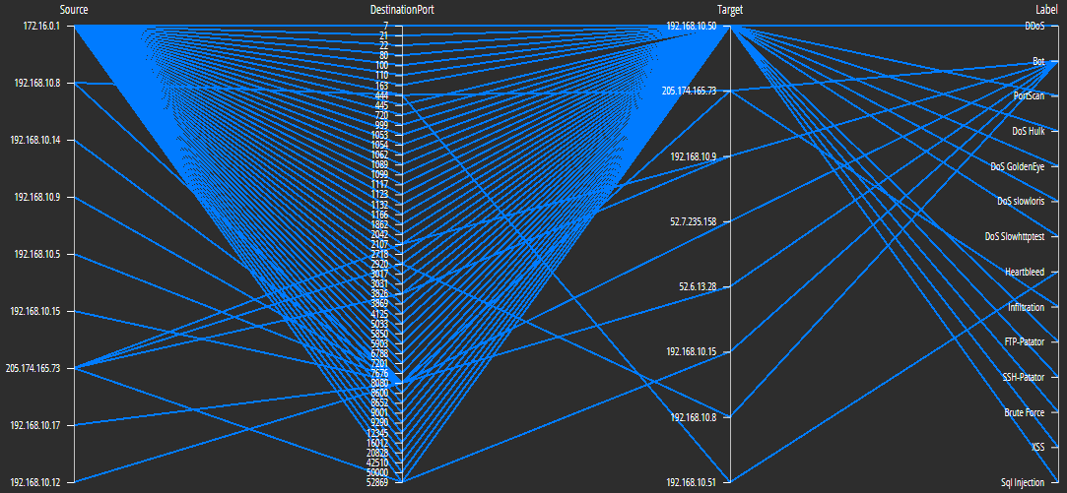
PCA
Axis:
Source
Destination Port
Target
Label
Each tuple in the dataset has been represented by a line, where this line intersects a specific value of these four parameters.

Slide 15
Visualizations
Graph
PCA
Scatterplot of attacks (compared to time)

Slide 16
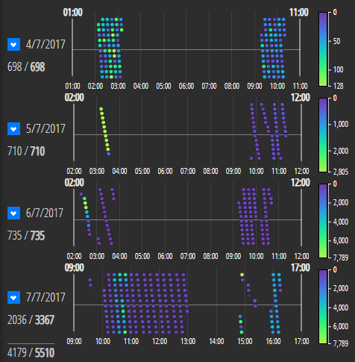
Scatterplot TIMESTAMP/ATTACK
Axis:
X: Timestamp
Y: (algorithm to avoid overlapping)
In this scatterplot, we have an overview of the attacks during the day. The Y-axis is calculated automatically so that the dots do not overlap.
Colour Of Dots : Based on the number of attack in that timestamp.

Slide 17
Visualizations
Graph
PCA
Scatterplot of attacks (compared to time)
Bar chart

Slide 18

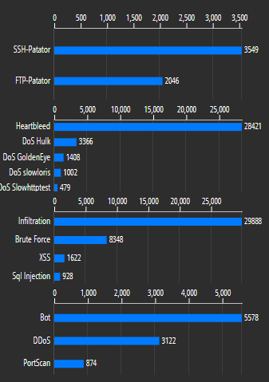
Bar Chart
Axis:
X: Number of attacks
Y: Type of attack
This graph gives us the opportunity to understand for each day the types of attack and the number of malicious packages sent.

Slide 19
Visualizations
Graph
PCA
Scatterplot of attacks (compared to time)
Bar chart
Scatterplot of Ports

Slide 20
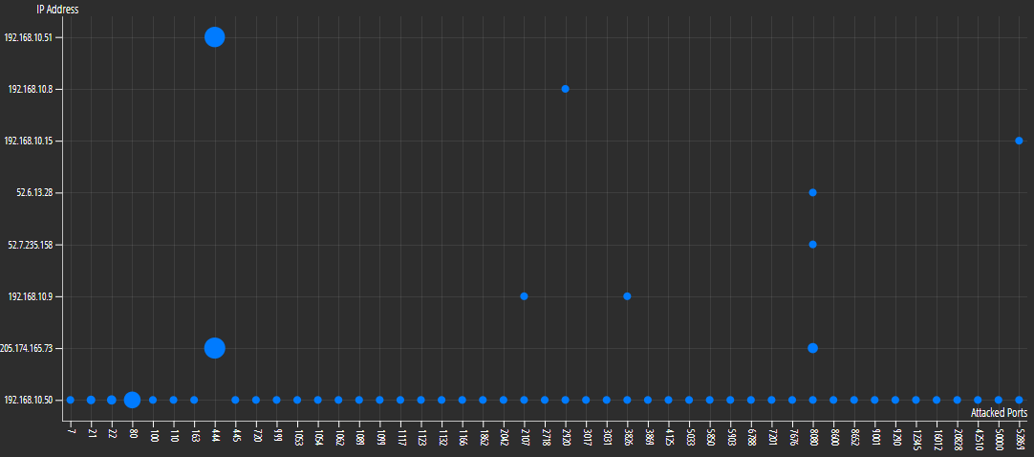
Scatterplot DESTINATION/PORTS
Axis:
X: Destination Port
Y: Targets IP address
The dot changes size based on how many attacks has been taken by the couple IP address-Port

Slide 21
Pipeline
DATASET
TECHNOLOGIES
VISUALIZATIONS
ACTIONS
FILTERS
Notes:
After talking about the various graphic elements for the representation of data, let's see what kind of actions you can perform on them.

Slide 22
Actions
Dbl Click
Graph
Total Port Number
Zoom
PCA
Drag
PCA
Mouse Move
Graph
PCA
Scatterplot Port
Mouse Out
Graph
PCA
Scatterplot Port
Click
Graph
Brush
Graph
PCA
Timestamp Axis
PCA
Timestamp Filter
Notes:
in our project, it is possible to perform different actions on different visualizations, so that we can provide to the end user many features.
now let's explain what these actions do.

Slide 23
Actions
Double Click
With the double click, we give the opportunity to the user to reset the filters carried out. In addition, double-clicking on the graph's nodes allows you to deselect it.
Zoom
On the PCA we have given the possibility to zoom, this is useful when you want to make a brush on the axis and the values are very close.
Drag
The PCA axis can be changed with a drag: the user can see the relationships between the axis where it is not possible, as they are not close to the axis of interest.
Mouse Out
When the mouse is no longer over objects that support the "mouse move", all actions triggered by it will be reset

Slide 24
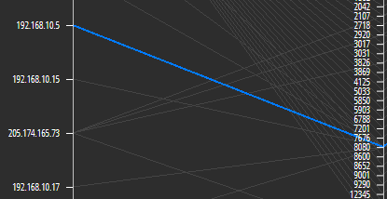

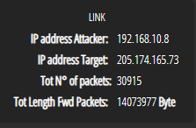
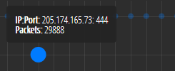
Actions
Mouse Move - LOCAL CHANGES
Graph:
Node – Show tooltip with extra info:
IP address
Number of malicious packages sent or delivered
Edge – Show tooltip with extra info:
IP address Attacker
IP address Target
Tot number of packets
Tot length of Fwd Packets [Byte]
PCA:
Edge – Focuses on the edge, reducing the opacity of all the others.
Ports Scatterplot
Dots – Focuses on the dot, reducing the opacity of all the others.
– Show tooltip with extra info:
IP address
Port
Packets
Focused edge
Node tooltip
Link tooltip
Focused dot + tooltip dot
Notes:
for the "mouse move", we can identify two types of changes: local or global changes.
when the mouse pointer is placed over the node and the graph edge is shown a window with extra information.
for the node is shown the IP address and the number of packets sent or received
while for the edge is shown …..
on the PCA instead, if the mouse pointer is placed over an edge it is highlighted while the other are hidden.
The same happens at the points of the "scatterplot" of the ports, in addition, is shown also a window with extra information that are: …

Slide 25
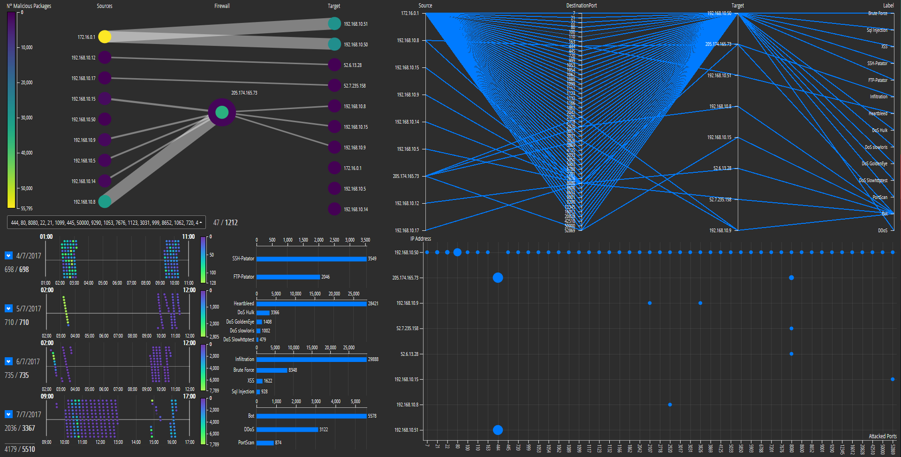
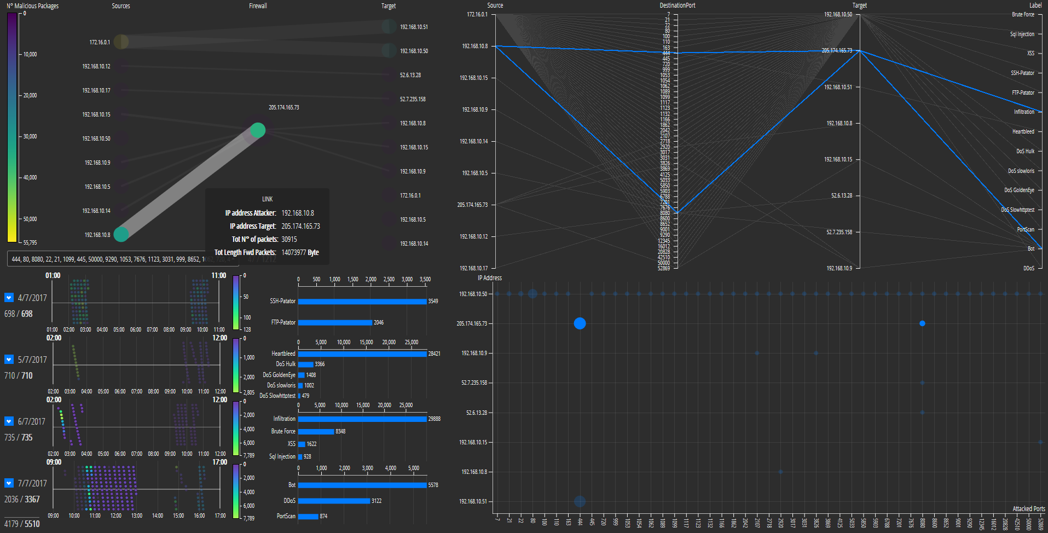
Actions
Mouse Move - GLOBAL CHANGES
Graph:
Node – PCA, Scatterplot Port, Scatterplot Over Time
Edge – PCA, Scatterplot Port, Scatterplot Over Time
PCA:
Edge – Graph, Scatterplot Port, Scatterplot Over Time
Scatterplot Port:
Dots – Graph, PCA, Scatterplot Over Time
Notes:
Each component that implements the "mouse move", in addition to having local changes, interacts with all the visualizations seen above.
so when we put the mouse pointer over the node the views change. in this case, the data of the node will be shown.

Slide 26
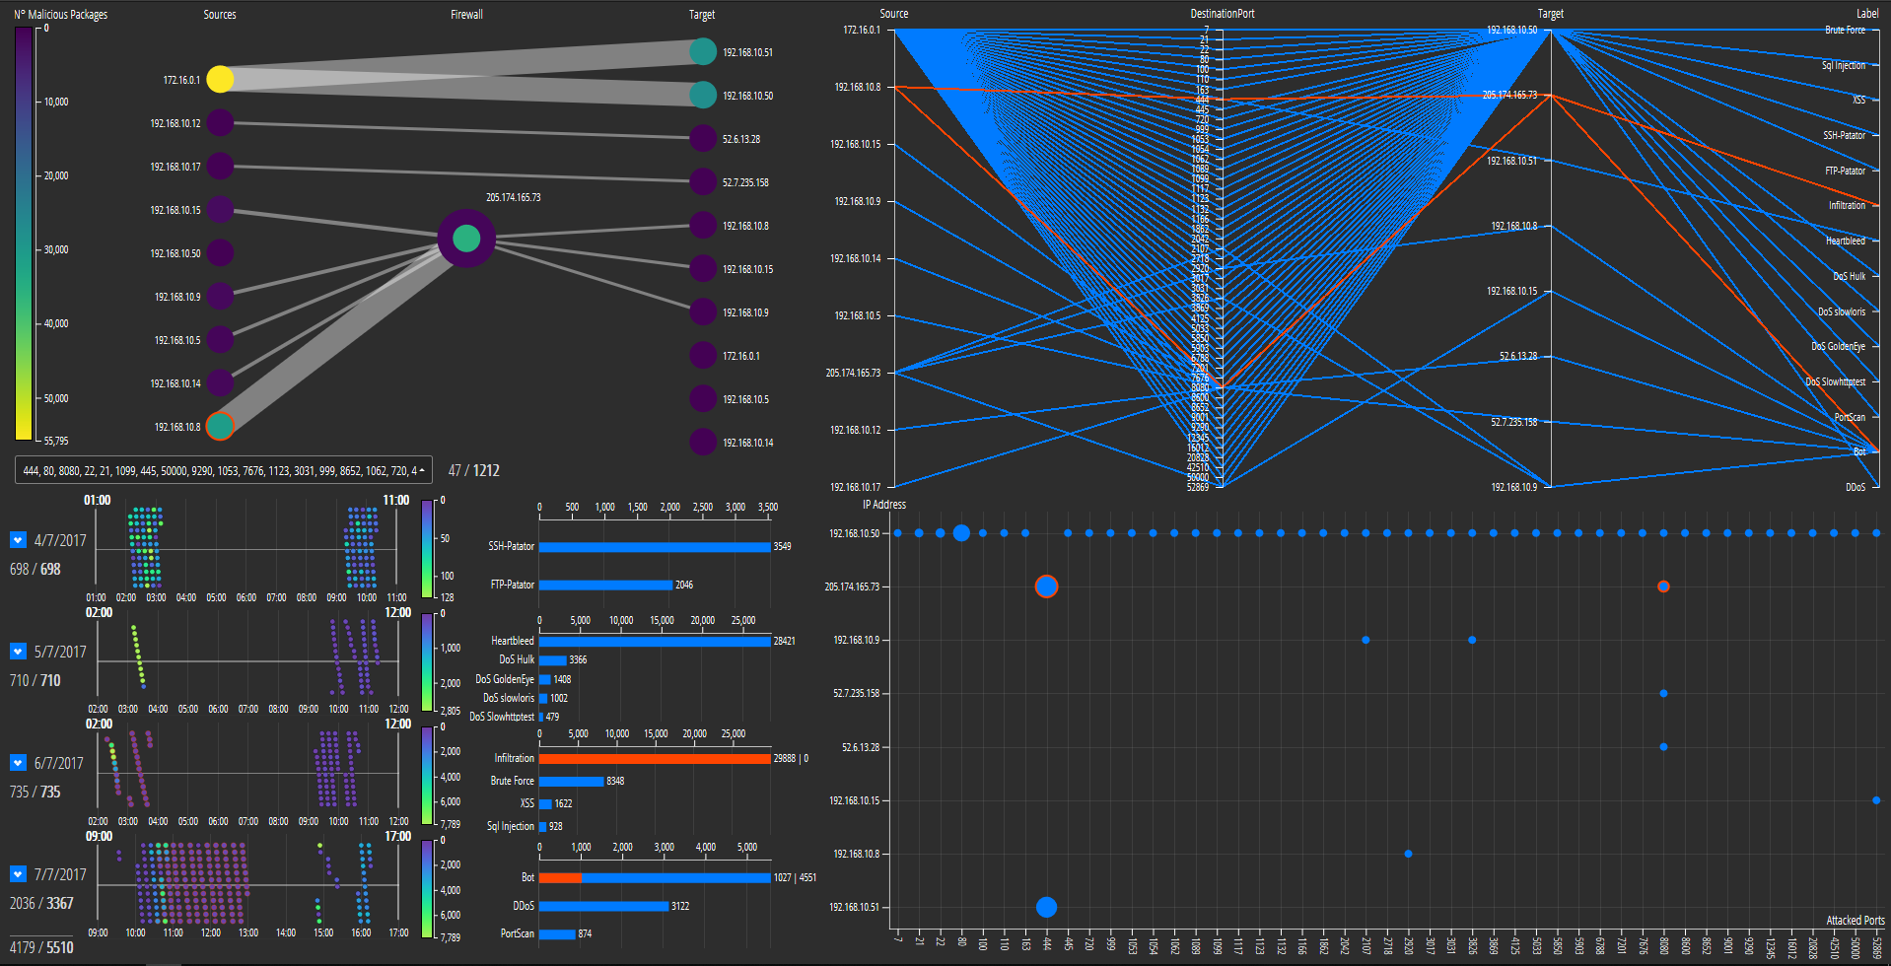
Actions
Click – GLOBAL AND LOCAL CHANGES
Graph:
Node – PCA, Scatterplot Port, Scatterplot Over Time, Bar Chart
Selected
Not Selected
Notes:
In addition to wanting to temporarily see the selection of the node with the "move mouse", we thought it might be useful to keep track of the data of interest. For this reason, we implemented the selection of the graph nodes.

Slide 27
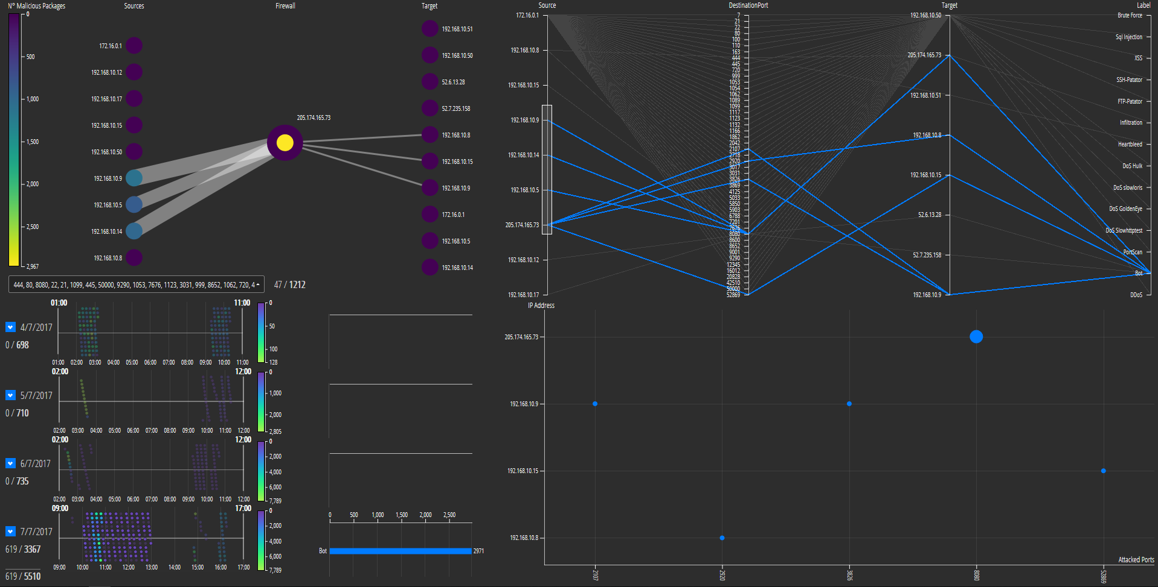
Actions
Brush – GLOBAL CHANGES
Graph:
Legend CPA, Scatterplot Port, Scatterplot Over Time
PCA:
Axis – PCA, Scatterplot Port, Scatterplot Over Time, Bar Chart
Timestamp:
Axis – PCA, Graph, Scatterplot Port, Bar Chart
Notes:
With the brush we go to perform a filtering, to make the visualizations more readable.

Slide 28
Pipeline
DATASET
TECHNOLOGIES
VISUALIZATIONS
ACTIONS
FILTERS

Slide 29
Filters
Timestamp:
Axis – Allows you to filter the dataset by time, giving you the ability to filter by day and by hours.
PCA:
Axis – Allows you to filter the dataset by Source IP, Destination Port, Target IP and Type of Attack
Graph
Legend – Allows you to filter the view by number of packets sent and delivered
Port filter
With a multiple selection field, you can filter the ports and see the percentage of use based on the total

Slide 30
DEMO

Slide 31
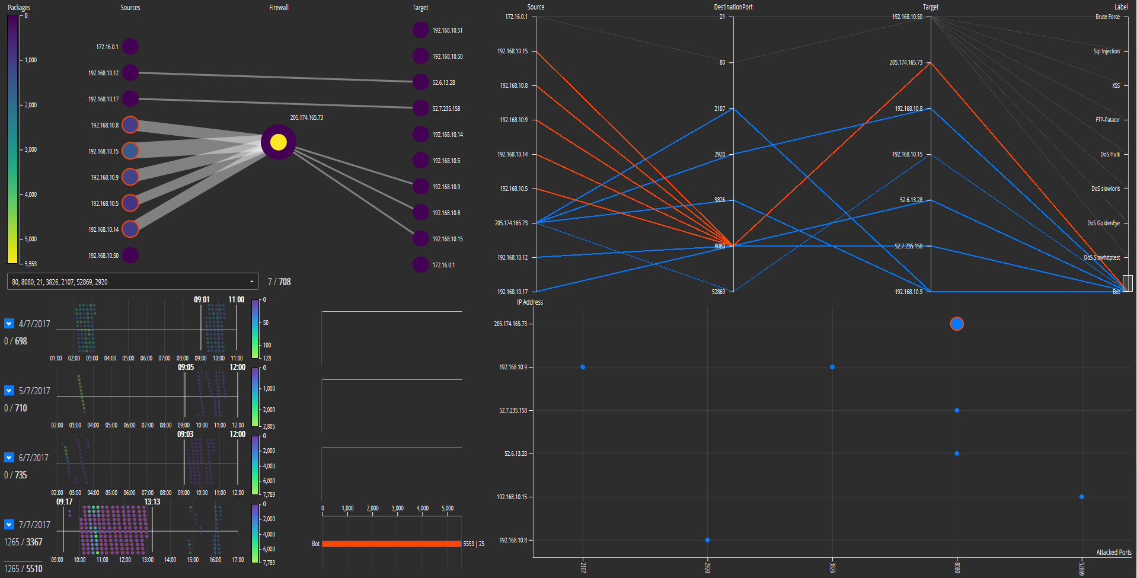
1° Filtering: Approx. 8:00 to 13:00 hours (filtering on timestamp) 2° Filtering: Selection of nodes that attack the firewall (filtering on the graph) 3° Filtering: Selection of the Bot connection to reduce the noise (filtering on PCA)

Slide 32
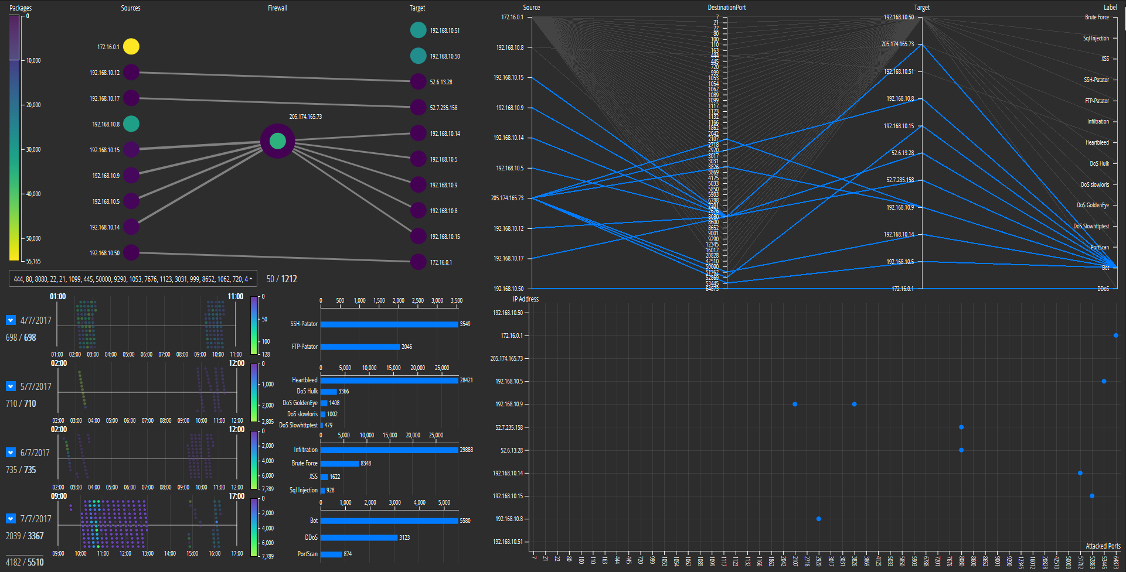
1° Filtering: Selection of ports 51762 53445 64873 (filtering on port selection form) 2° Filtering: Number of packages on legend from 0 to 10000 (filtering on graph)

Slide 33
Observations
The most common port is 444 (67%).
205.174.165.73 is a firewall.
172.16.0.1 is the attacker that sends the highest number of packets.
the 5th is the day in which were presented the highest different types of attacks
The attack usually appear during the night/early morning
Portscan is the most frequent attack that appears on each port

Slide 34
References
GitHub https://github.com/AlessandroGiannetti/VisualAnalytics
Slide https://www.slideshare.net/AlessandroGiannetti3/visual-network-analysis-148780273/AlessandroGiannetti3/visual-network-analysis-148780273
Alessandro Giannetti https://www.linkedin.com/in/alessandro-giannetti-2b1864b4/
Gianluca Tasciotti https://www.linkedin.com/in/gianluca-tasciotti-77124b174/

